Slide 1
Lecture 08: Specification and Testing
Understand software specification, precondition, program bugs, testing and debugging
Kok-Seng Wong | 2021

Slide 2
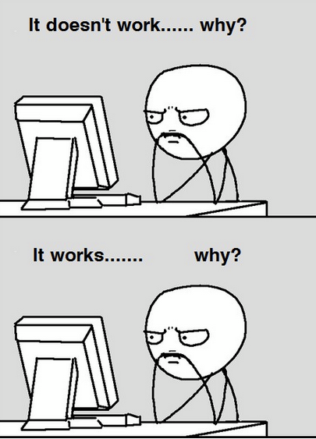
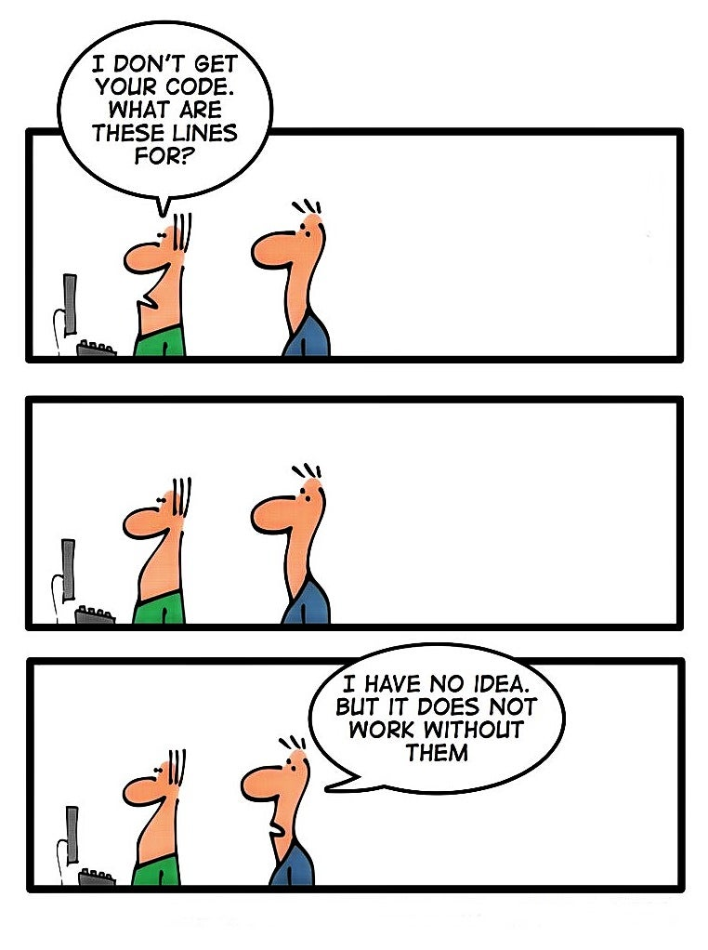
Motivation example 1
[source]
[source]

Slide 3
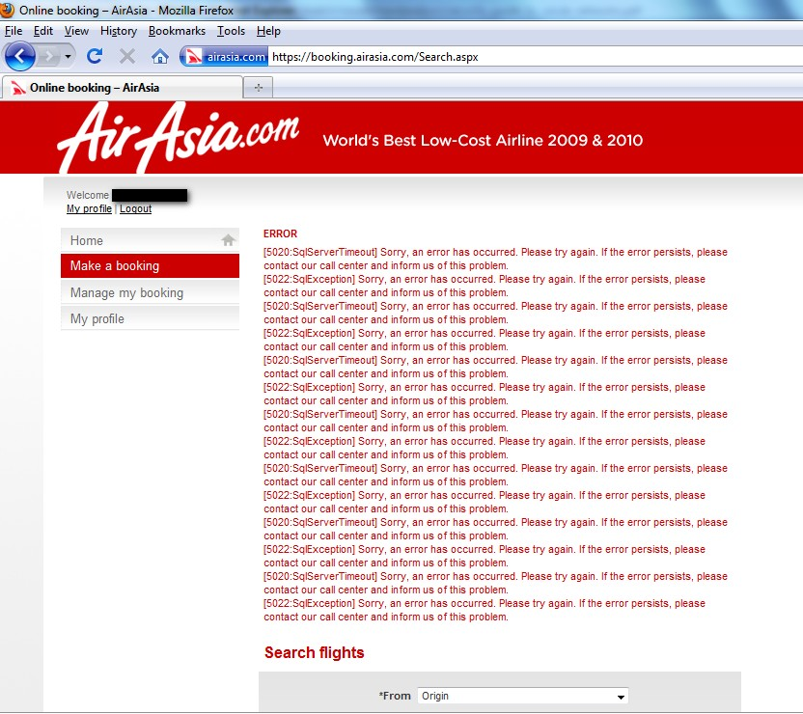
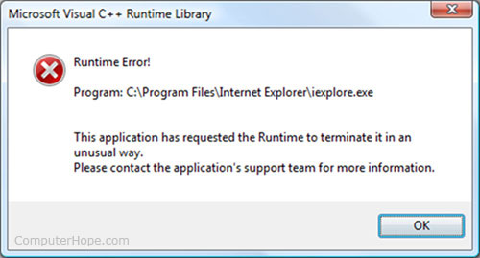
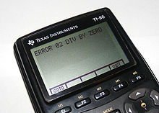
Motivation example 2
[source]
[source]

Slide 4
Learning outcomes
Upon the completion of this lecture, students will be able to:
understand the anatomy of a specification.
explain the basic terminology (bug, debugging, test, testing) in programming.
identify different types of errors (syntax, runtime, semantic) in program.

Slide 5
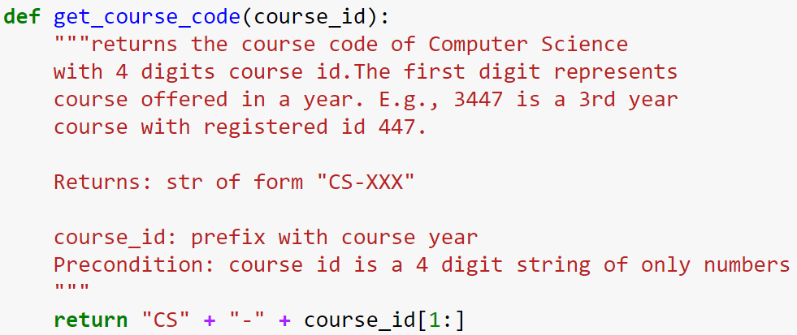
Anatomy of a specification
short description, followed by blank line
Parameter description
Information (with format) about the return value
Precondition specifies assumptions we make about the arguments

Slide 6
precondition
Precondition: a condition that must always be true just prior to the execution of some section of codes or before an operation in a formal specification.
If a precondition is violated, the effect of the section of code becomes undefined.
It may or may not carry out its intended work.

Slide 7
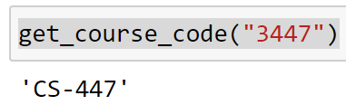
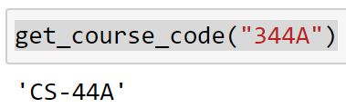
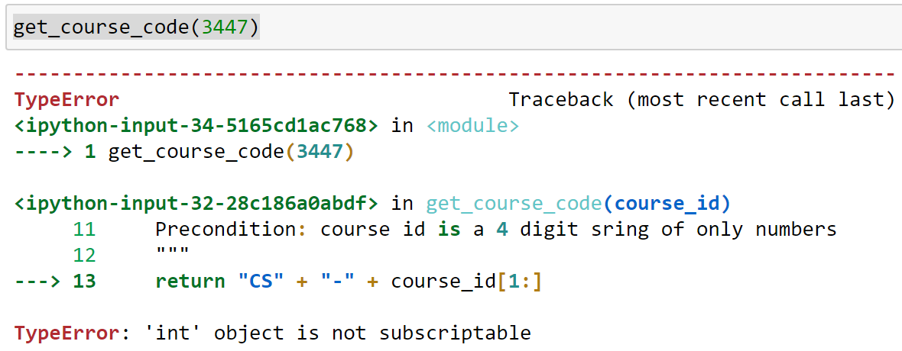
Precondition is a contract
If precondition is met, the function will work!
Else, no guarantees…
Precondition violated:
No Error Message!
Precondition violated:
With Error Message!

Slide 8
Basic terminology
Bugs: errors in a program
Debugging: the process of finding bugs and removing them
Testing: the process of analyzing and running a program (looking for bugs)
Test Case: a set of input values, together with the expected output

Slide 9
What is debugging?
Programming errors are called bugs.
The process of tracking bugs and correcting them is called debugging.
“The art of debugging is figuring out what you really told your program to do rather than what you thought you told it to do.” — Andrew Singer

Slide 10
Errors in program
Three kinds of errors can occur in a program:
Syntax errors
Runtime errors
Semantic errors

Slide 11
Syntax errors
Python can only execute a program if the program is syntactically correct.
Otherwise, the process fails and returns an error message.
Syntax: structure of a program and the rules about that structure.
If there is a single syntax error anywhere in your program, Python will print an error message and quit!
Who or what typically finds syntax errors?
(a) Compiler / interpreter (b) Programmer (c) Computer

Slide 12
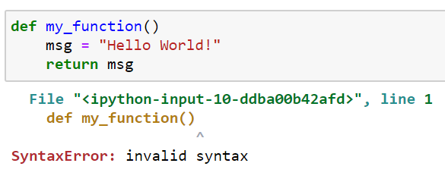
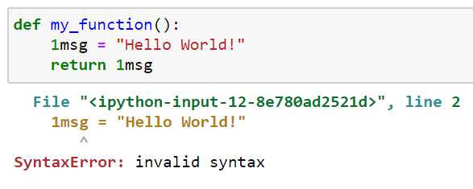
Syntax error – examples
A
B

Slide 13
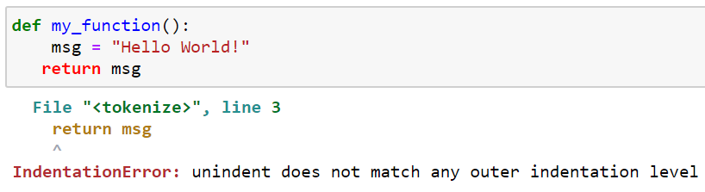
indentation error - example
Indentation error also indicates a problem with the syntax of your program.
More specific: it always means that there is a problem with how your code is indented.
An IndentationError is a kind of SyntaxError

Slide 14
Runtime errors
Runtime error does not appear until you run the program.
Also known as exceptions because they usually indicate that something exceptional (and bad) has happened.
division by zero
operation on incompatible types
using undefined identifier
accessing a list element, dictionary value or object attribute which doesn’t exist
Who or what typically finds runtime errors?
(a) Compiler / interpreter (b) Programmer (c) Computer

Slide 15
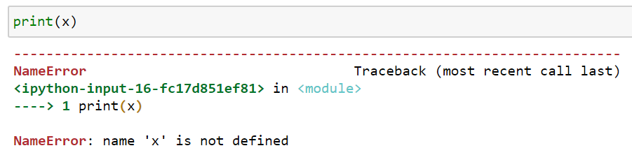
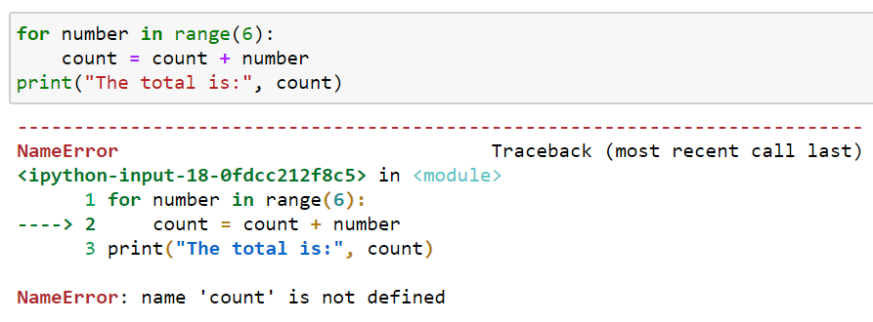
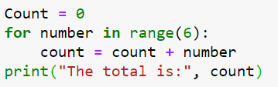
Runtime error – examples
In Python, all variables are expected to be defined before use.
A
Any Error?
B

Slide 16
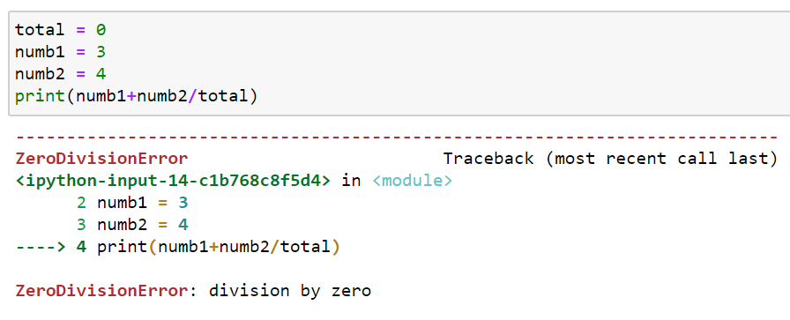
Runtime error – zero_division

Slide 17
Semantic errors
Also known as logical errors.
If there is a semantic error in your program, it will run successfully, in the sense that the computer will not generate any error messages, but it will not do the right thing.
The problem is that the program you wrote is not the program you wanted to write.
The meaning of the program (its semantics) is wrong.
Who or what typically finds semantic errors?
(a) Compiler / interpreter (b) Programmer (c) Computer

Slide 18
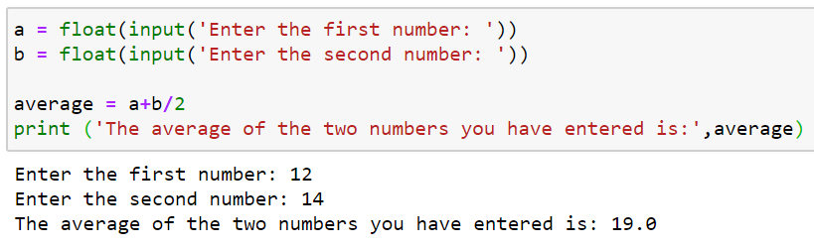
Semantic error - example

Slide 19
Experimental debugging
Debugging: a popular term used to process, locating and rectifying errors in a program.
Python's standard library contains pdb module which is a set of utilities for debugging of Python programs.
More info: https://docs.python.org/3/library/pdb.html

Slide 20
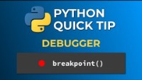

Slide 21
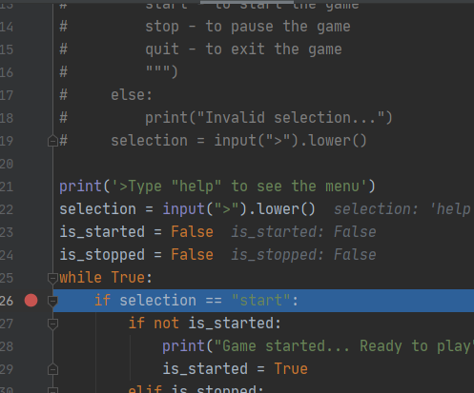
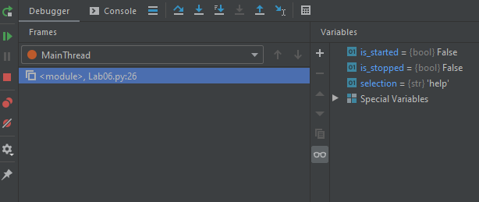
Pycharm debugging - example

Slide 22
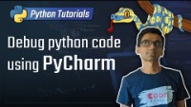

Slide 23
Test cases
Test cases: different types of inputs to your code to test your defined logic and produce the output.
A test case is termed “passed” when the output from your code exactly matches the expected output.
It helps to identify errors in the specification as well as the implementation.

Slide 24
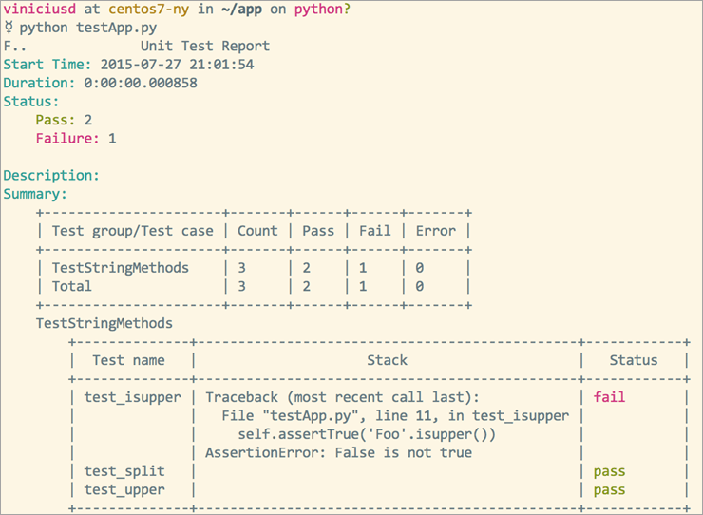

Slide 25
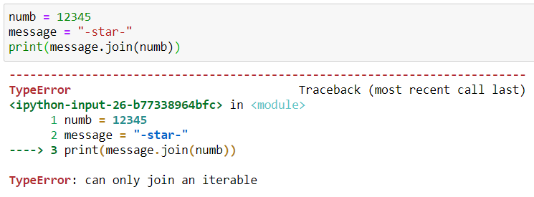
Identify types of errors
join(): takes iterable – objects capable of returning its members one at a time

Slide 26
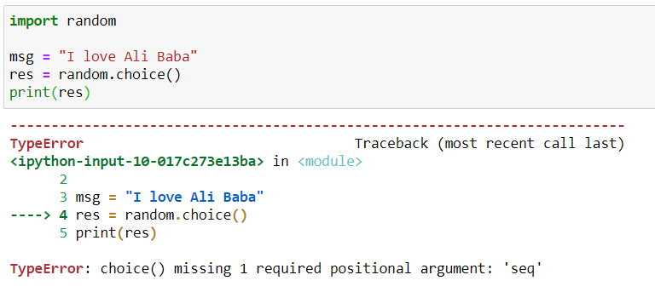
Identify types of errors
choice(): randomly choose an item from a sequence type.

